Slide 1
Hierarchical Task Network Planning

Slide 2
Motivation
We may already have an idea how to go about solving problems in a planning domain
Example: travel to a destination that’s far away:
  Domain-independent planner:
    many combinations vehicles and routes
  Experienced human: small number of “recipes”
    e.g., flying:
      buy ticket from local airport to remote airport
      travel to local airport
      fly to remote airport
      travel to final destination
How to enable planning systems to make use of such recipes?

Slide 3
Two Approaches
Control rules (previous chapter):
  Write rules to prune every action that doesn’t fit the recipe
Hierarchical Task Network (HTN) planning:
  Describe the actions and subtasks that do fit the recipe

Slide 4
HTN Planning
Task:
travel(x,y)
Method: taxi-travel(x,y)
Method: air-travel(x,y)
get-taxi
ride(x,y)
pay-driver
get-ticket(a(x),a(y))
fly(a(x),a(y))
travel(a(y),y)
travel(x,a(x))
travel(Sharif, Ferdowsi)
get-ticket(Sharif, Ferdowsi)
get-ticket(THR, MSH)
travel(Sharif, THR)
fly(THR, MSH)
travel(MSH, Ferdowsi)
go-to-agency
find-flights(Sharif, Ferdowsi)
go-to-agency
find-flights(THR, MSH)
buy-ticket(THR, MSH)
Problem reduction
  Tasks (activities) rather than goals
  Methods to decompose tasks into subtasks
  Enforce constraints
    E.g., taxi not good for long distances
  Backtrack if necessary
BACKTRACK
get-taxi
ride(Sharif, THR)
pay-driver
get-taxi
ride(MSH, Ferdowsi)
pay-driver

Slide 5
Decomposition
Shows the order plan
will be executed later
Non-primitive task
method instance
precond
primitive task
primitive task
Non-primitive task
operator instance
operator instance
s₀
precond
effects
s₁
precond
effects
s₂

Slide 6
Simple Task Network (STN) Planning
A special case of HTN planning
States and operators
  The same as in classical planning
Task: an expression of the form t(u₁,…,u_{n})
  t is a task symbol, and each u_{i} is a term
  Two kinds of task symbols (and tasks):
    primitive: tasks that we know how to execute directly
      task symbol is an operator name
    nonprimitive: tasks that must be decomposed into subtasks
      use methods (next slide)

Slide 7
Methods
Totally-ordered method: a 4-tuple
m = (name(m), task(m), precond(m), subtasks(m))
  name(m): an expression of the form n(x₁,…,x_{n})
    x₁,…,x_{n} are parameters - variable symbols
  task(m): a nonprimitive task
  precond(m): preconditions (literals)
  subtasks(m): a sequence
  of tasks ⟨t₁, …, t_{k}⟩
air-travel(x,y)
  task: travel(x,y)
  precond: long-distance(x,y)
  subtasks: ⟨buy-ticket(a(x),a(y)), travel(x,a(x)), fly(a(x),a(y)),
  travel(a(y),y)⟩
travel(x,y)
air-travel(x,y)
long-distance(x,y)
buy-ticket (a(x), a(y))
travel (x, a(x))
fly (a(x), a(y))
travel (a(y), y)

Slide 8
Methods
Partially ordered method: a 4-tuple
m = (name(m), task(m), precond(m), subtasks(m))
  name(m): an expression of the form n(x₁,…,x_{n})
    x₁,…,x_{n} are parameters - variable symbols
  task(m): a nonprimitive task
  precond(m): preconditions (literals)
  subtasks(m): a partially ordered
  set of tasks {t₁, …, t_{k}}
air-travel(x, y)
  task: travel(x, y)
  precond: long-distance(x, y)
  network: u₁=buy-ticket(a(x), a(y)), u₂= travel(x, a(x)), u₃= fly(a(x), a(y))
  u₄= travel(a(y), y), {(u₁, u₃), (u₂, u₃), (u₃, u₄)}
travel(x,y)
air-travel(x,y)
long-distance(x,y)
buy-ticket (a(x), a(y))
travel (x, a(x))
fly (a(x), a(y))
travel (a(y), y)

Slide 9
Domains, Problems, Solutions
STN planning domain: methods, operators
STN planning problem: methods, operators, initial state, task list
Total-order STN planning domain and planning problem:
  Same as above except that
  all subtasks are totally ordered
Solution: any executable plan
that can be generated by
recursively applying
  methods to
  nonprimitive tasks
  operators to
  primitive tasks
nonprimitive task
method instance
precond
primitive task
primitive task
operator instance
operator instance
s₀
precond
effects
s₁
precond
effects
s₂

Slide 10
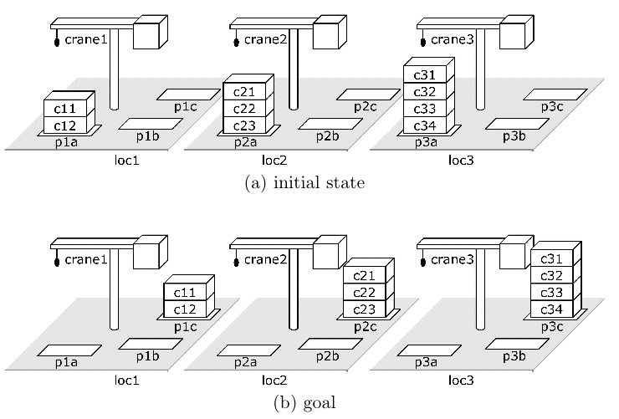
Example
Suppose we want to move three stacks of containers in a way that preserves the order of the containers

Slide 11
Example (continued)
A way to move each stack:
  first move the
  containers
  from p to an
  intermediate
  pile r
  then move
  them from
  r to q

Slide 12
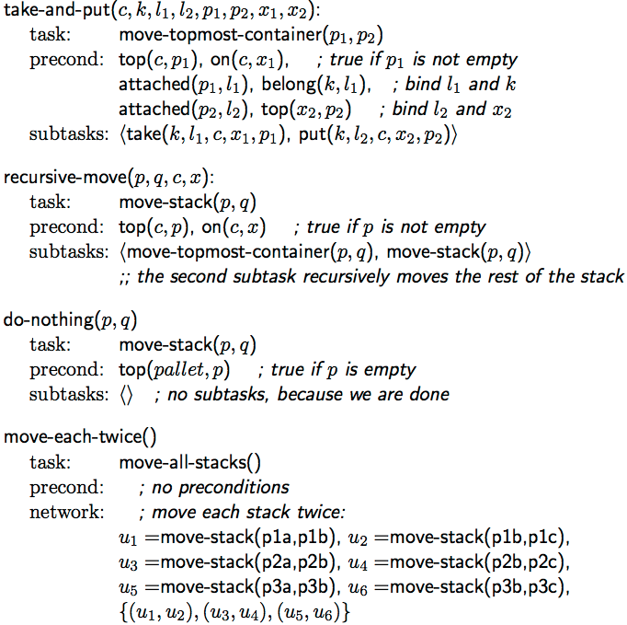
Partial-Order Formulation

Slide 13
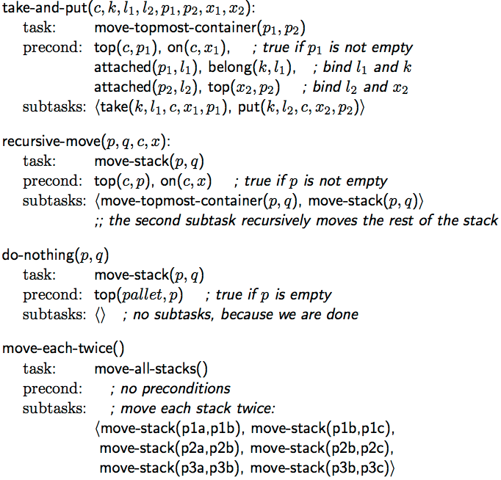
Total-Order Formulation

Slide 14
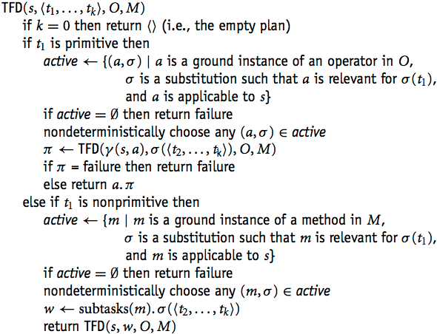
Solving Total-Order STN Planning Problems
state s; task list T=( t₁ ,t₂,…)
action a
state γ(s,a) ; task list T=(t₂, …)
task list T=( t₁ ,t₂,…)
method instance m
task list T=( u₁,…,u_{k} ,t₂,…)

Slide 15
Comparison to
Forward and Backward Search
In state-space planning, must choose whether to search
forward or backward
In HTN planning, there are two choices to make about direction:
  forward or backward
  up or down
TFD goes
down and
forward
s₀
op₁
s₁
op₂
s₂
…
S_{i–1}
op_{i}
…
task t₀
task t_{m}
…
task t_{n}
s₀
op₁
s₁
op₂
s₂
…
S_{i–1}
op_{i}
…

Slide 16
Comparison to
Forward and Backward Search
Like a backward search,
TFD is goal-directed
  Goals
  correspond
  to tasks
Like a forward search, it generates actions
in the same order in which they’ll be executed
Whenever we want to plan the next task
  we’ve already planned everything that comes before it
  Thus, we know the current state of the world
task t₀
task t_{m}
…
task t_{n}
s₀
op₁
s₁
op₂
s₂
…
S_{i–1}
op_{i}
…

Slide 17
Increasing Expressivity Further
Knowing the current state makes it easy to do things that would be difficult otherwise
  States can be arbitrary data structures
  Preconditions and effects can include
    logical inferences (e.g., Horn clauses)
    complex numeric computations
e.g., SHOP:
    http://www.cs.umd.edu/projects/shop

Slide 18
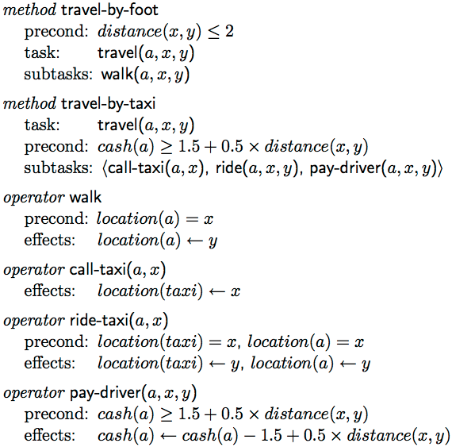
Example
Simple travel-planning domain
  Go from one location to another
  State-variable formulation

Slide 19
Planning Problem:
I am at home, I have $20,
I want to go to a park 8 miles away
Initial task:
travel(me,home,park)
home
park
travel-by-foot
travel-by-taxi
Precond: distance(home,park) ≤ 2
Precond: cash(me) ≥ 1.50 + 0.50*distance(home,park)
Precondition fails
Precondition succeeds
Decomposition into subtasks
s₀
call-taxi(me,home)
s₁
ride(me,home,park)
s₂
pay-driver(me,home,park)
s₃
Initial
state
Precond: …
Effects: …
Precond: …
Effects: …
Precond: …
Effects: …
Final state
s₀ = {location(me)=home, cash(me)=20, distance(home,park)=8}
s₁ = {location(me)=home, location(taxi)=home, cash(me)=20, distance(home,park)=8}
s₂ = {location(me)=park, location(taxi)=park, cash(me)=20, distance(home,park)=8
s₃ = {location(me)=park, location(taxi)=park, cash(me)=14.50, distance(home,park)=8}

Slide 20
Limitation of Ordered-Task Planning
get-both(p,q)
Cannot interleave subtasks of different tasks
Sometimes this can make things awkward
Need methods that reason globally instead of locally
get(p)
get(q)
walk(a,b)
pickup(p)
walk(b,a)
walk(a,b)
pickup(q)
walk(b,a)
get-both(p,q)
goto(b)
pickup-both(p,q)
goto(a)
walk(a,b)
pickup(p)
pickup(q)
walk(b,a)

Slide 21
Generalize the Methods
Generalize methods to allow the subtasks to be partially ordered
Consequence: plans may interleave subtasks of different tasks
This makes the planning algorithm more complicated
get-both(p,q)
get(p)
get(q)
walk(a,b)
stay-at(b)
pickup(p)
pickup(q)
walk(b,a)
stay-at(a)

Slide 22
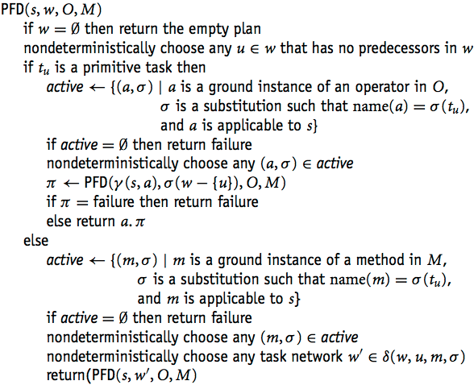
Generalize TFD to interleave subtasks
π={a₁,…, a_{k}}; w={ t₁ ,t₂, t₃…}
operator instance a
π={a₁ …, a_{k}, a }; w’={t₂,t₃ …}
w={ t₁ ,t₂,…}
method instance m
w’={ u₁,…,u_{k} ,t₂,…}

Slide 23
Generalize TFD to interleave subtasks
δ(w, u, m, σ) has a complicated definition in the book. Here’s what it means:
  We selected t₁ because it’s possible for t₁ to come first
  We’re planning for t₁ under the assumption that it will come first
  Insert ordering constraints to ensure it will come first
  The same constraints also must apply to all subtasks of t₁
w={ t₁ ,t₂,…}
method instance m
w’={ u₁,…,u_{k} ,t₂,…}

Slide 24
Discussion
PFD is sound and complete
Can generalize in the same ways as TFD
SHOP2: implementation of PFD-like algorithm + generalizations
  Won one of the top four awards in the AIPS-2002 Planning Competition
  Freeware, open source
  Implementation available at
    http://www.cs.umd.edu/projects/shop

Slide 25
HTN Planning
HTN planning is even more general
  Can have constraints associated with tasks and methods
    Things that must be true before, during, or afterwards
  Uses causal links and threats like those in PSP

